Slide 1
Wesleyan University Your 2024 Delta Dental Plans

Slide 2
New This Year with your Dental Plan
Introducing additional benefits for those with
Special Healthcare Needs.
All other benefits remain the same.
.

Slide 3
Visit www.DeltaDentalCT.com/FAD
to find a dentist.
Choosing dentists with the “Greater Savings” icon helps you keep more money in your pocket.
Delta Dental PPO Plus Premier™
Nationwide Networks
If you use a Delta Dental PPO™ dentist
Your out-of-pocket costs will be lowest for services if you use a participating
PPO dentist.
Your annual maximum stretches further because the PPO dentists' fees are lower.
Participating dentists may not charge more than Delta Dental’s allowed charges and are paid directly by Delta Dental for covered services.
If you use a Delta Dental Premier® dentist
Our largest nationwide network.
Your out-of-pocket costs will be higher, and your plan maximum will not go as far, since Premier dentists' fees are not as discounted as PPO dentists
Participating dentists may not charge more than Delta Dental’s allowed charges, and are paid directly by Delta Dental for covered services
You may use dentists that do not participate with Delta Dental
You are responsible for submitting the claim
You are responsible for making payment to the dentist
Your out-of-pocket costs are highest when you use non-participating dentists

Slide 4
Your Dental Plan Options

Slide 5
Plan Summaries
Wesleyan University PPO Plus Premier Overview Group # 6507 | Core Plan | Buy-up Plan
Calendar Year Deductible Per Person Per Family | $50 $150 waived on Preventive & Diagnostic Services | $50 $150 waived on Preventive & Diagnostic Services
Calendar Year Maximum (per person) | $1,200 | $2,000
Preventive & Diagnostic* Exams, Cleanings (2 per calendar year per person) Bitewing X-Rays (2 per calendar year per person to age 19 only) Fluoride Treatment (2 per calendar year to age 19) Full Mouth X-Rays (1 set every five years) Space Maintainers *Preventive & Diagnostic Services are not subject to the Calendar Year Maximum. | 100% | 100%
Basic (After Deductible) Fillings (including composites), Extractions Endodontics, Periodontal Oral Surgery Sealants (To Age 16) | 80% | 80%
Major (After Deductible) Crowns, Gold Restorations Bridgework, Full & Partial Dentures Repair of Dentures Implants | 50% | 60%
Orthodontia (Adult & Child) Coinsurance Lifetime Maximum | 50% $1,500 | 50% $2,000

Slide 6
Special Health Care Needs Benefit
What is included?
Additional dental examinations and/or consultations that can be beneficial prior to treatment to help patients learn what to expect and what is needed for a successful dental appointment.
Up to four total dental cleanings in a benefit year.
Treatment delivery modifications (including anesthesia and nitrous oxide) necessary for dental staff to provide oral health care for patients with sensory sensitivities, behavioral challenges, severe anxiety, or other barriers to treatment.
How do I/my spouse/my dependent use this benefit?
Members with a qualifying special health care need should let their dentist know that their group Delta Dental plan includes the Special Health Care Needs Benefit and that they have a qualifying special health care need.

Slide 7
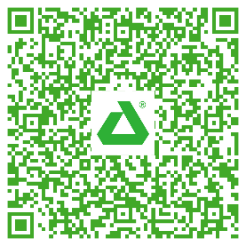
Special Health Care Needs Benefit
Questions?
Please call the Delta Dental Customer Service Department at 800-452-9310.
Dentist education flyer
To help your dentist better understand the benefit and how to bill Delta Dental for services provided, we suggest you share the
Special Health Care Needs flyer with them.
Or snap the QR code to download/share the flyer with
your dentist.

Slide 8
Carryover MaxSM (COM)
Allows members to carry over part of their unused annual maximum.
To qualify you must have one cleaning or exam during the calendar year.
You used up less than half of your Annual Maximum.
You can carry over up to 25% of the unused portion of your regular annual maximum up to $500 per year.
The accumulated amount can never exceed your standard annual maximum.
The chart below is a three-year example of how Carryover Max is applied based on a member’s standard annual maximum amount of $1,000.
Your standard annual maximum amount | Year 1 $1,000 | Year 2 $1,000 | Year 3 $1,000
Carryover amount from previous year | N/A | $150 | $150
Total benefit dollars available | $1,000 | $1,150 | $1,150
Your total claims paid* | $400 | $800 | $1,100**
 | (less than $500) | (more than $500) | (more than $500)
Cleaning or oral exam during the prior year | Yes | Yes | Yes
Carryover amount earned | $150 | $0 | $0
Accumulated Carryover Max total available*** | $150 | $150 | $50
* If you use less than one half of your standard annual maximum, then you are eligible for Carryover Max.
** In year three, the $1,000 standard annual maximum was exceeded, but the member had enough Carryover Max dollars accumulated ($150) to cover the additional $100 cost.
*** If you fail to see a dentist at least once during the benefit year for an oral evaluation (exam) or prophylaxis (cleaning) and submit a claim to Delta Dental for that service, your accumulated Carryover Max will revert to zero and you will begin another accumulation process.

Slide 9
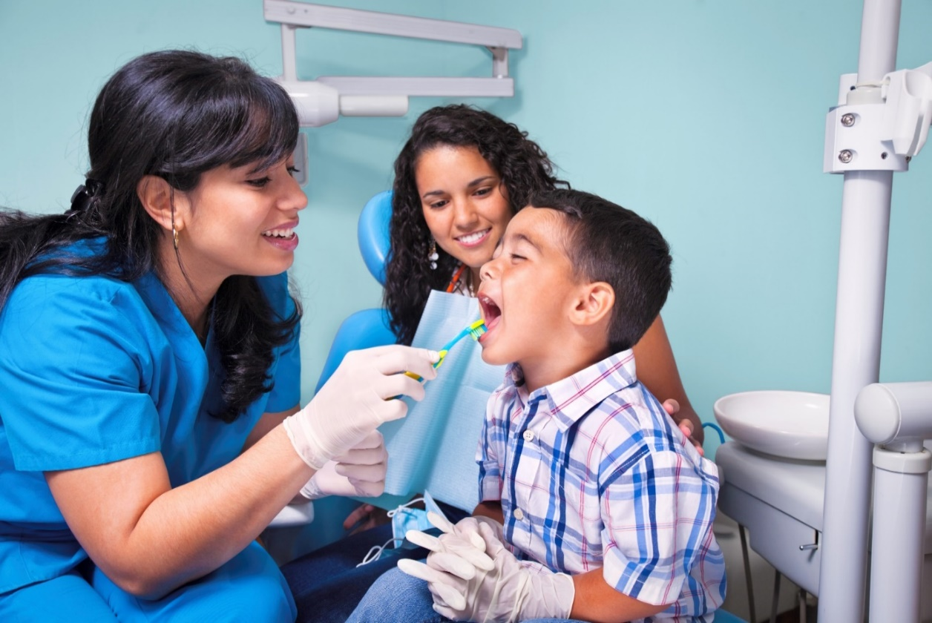
Member Experience

Slide 10
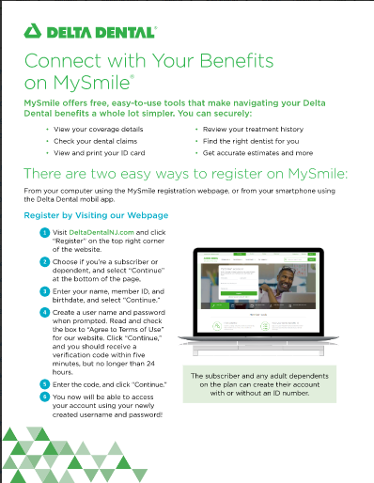
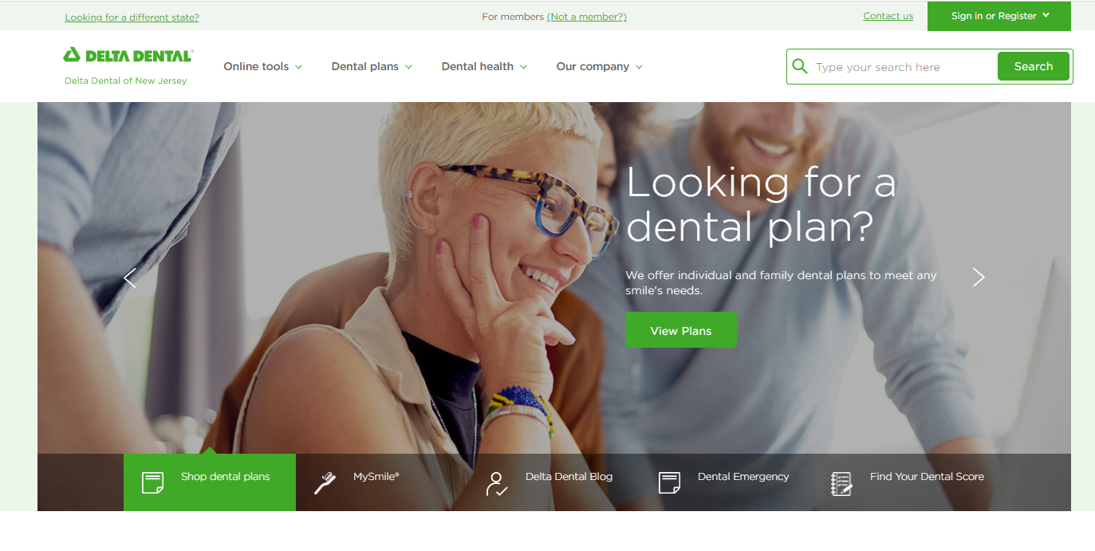
Delta Dental Website
Register and log into your My Smile® account at www.deltadentalct.com/websterbank to access your dental benefits.
Use the same log in information to access your dental benefits information in the Delta Dental App.
Need a dentist? Click our ‘Find a Dentist’ to search for a dentist near you.
Watch this!
Navigating the website
New Page
Member dashboard
Find and recommend a dentist
Your EOB Explained
Why it pays to stay in network
Step-by-Step
Member Registration

Slide 11
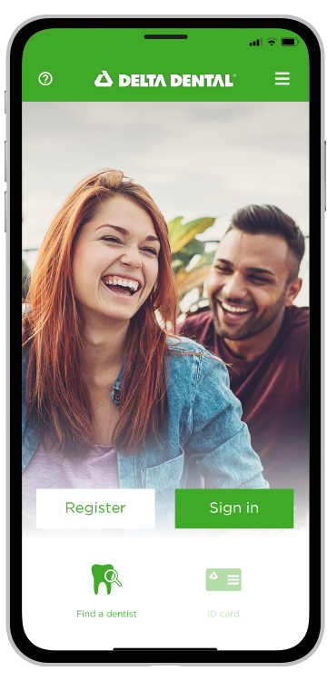
Delta Dental Mobile App
Register or Log in
ID card
Find a Dentist in your Plan Network
Save Your Preferred Dentist
Review Claims and Coverage
Cost Estimator
MyDentalScore Risk Assessment

Slide 12
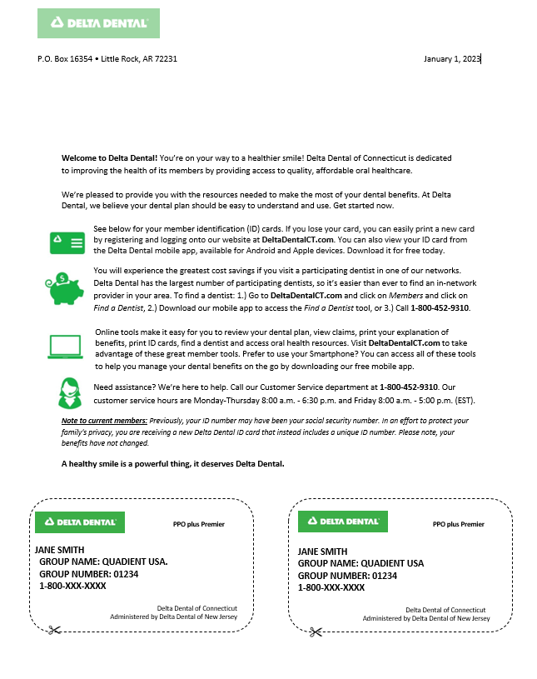
Dental ID Cards
Everyone enrolled will receive ID Cards for dental plan.
Unique Member ID Number.
2 subscriber only ID cards issued.
Additional ID cards are available through our member portal, MySmiles.
PPO plus Premier
PPO plus Premier
JANE SMITH Member ID: 1234567890 GROUP NAME: WESLEYAN UNIVERSITY GROUP NUMBER: 06507 1-800-XXX-XXXX
Delta Dental of Connecticut
Administered by Delta Dental of New Jersey
Delta Dental of Connecticut
Administered by Delta Dental of New Jersey
For your PPO Plus Premier Plan
Your ID cards are available online in the MySmile Portal at: https://www.deltadentalct.com/

Slide 13
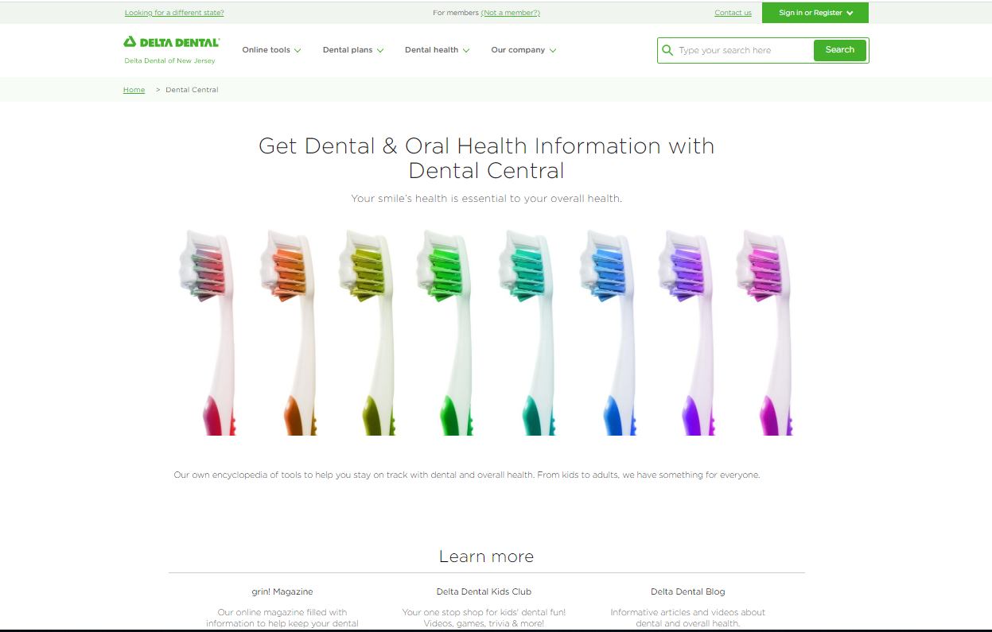
Oral Health and Wellness Information
Your One-Stop Dental Resource Hub
Library of articles on oral health & wellness
Videos on dental topics
Oral health risk assessment tool – MyDentalScore.com
Grin! Magazine – quarterly online wellness magazine
Resources on:
Smoking Cessation
Hygiene Practices
Vegan Diet

Slide 14
We want you to feel healthy and to love your smile!
Taking good care of your teeth is an important part of taking good care of yourself.
Brush and floss your teeth twice a day.
Go to the dentist twice a year.
If you have pain in your mouth, don’t delay, visit your dentist.
Tell your dentist about any medical conditions you have like diabetes, cardiac disease or pregnancy.
Protect your teeth from injury - wear a mouth guard when playing sports.
Find a dentist that is conveniently located for you that offers hours that work for you and your family.

Slide 15
Dental emergency? Use our Virtual Visits service!
Delta Dental Virtual Visits, delivered by TeleDentistry.com,
provides 24/7 access to a dentist, 365 days a year, for our members.
You can use Delta Dental Virtual Visits when:
Having a dental emergency while on vacation, during holidays, or away from home.
Needing access to a licensed dentist after hours or if your dentist is unavailable.
Having a dental emergency and you do not have an established dentist.
You should always try to access your regular dentist before using the Virtual Visits service.
To get started, call our 24/7 hotline at 866-443-1882 or visit www.DeltaDentalCT.com/VirtualVisits.
Delta Dental’s Virtual Visits service is provided by Teledentistry.com. This service is a covered benefit in most Delta Dental of Connecticut plans for currently enrolled members.
Please note that a Virtual Visit is a “problem-focused exam” and counts as one of your annual examinations covered by your plan.

Slide 16
Connect with Delta Dental
Delta Dental (Wesleyan University)
Group # 06507
Customer Service 800-452-9310
Call, go online or download our mobile app for these services:
Verify eligibility
Review benefits
Look up claim payments
Find a dentist
Cost Estimator – on mobile app
Print an ID card – or have it on your phone
Website: www.deltadentalct.com

